Slide 1





FLIGHT XI
W261 Final Project Phase III – Group 11 – March 29, 2022
Jeff Adams, Jenny Conde, Dante Malagrino, Joy Moglia, Ram Senthamarai
Notes:
[DANTE]
Welcome to the Phase III update from team Flight XI

Slide 2
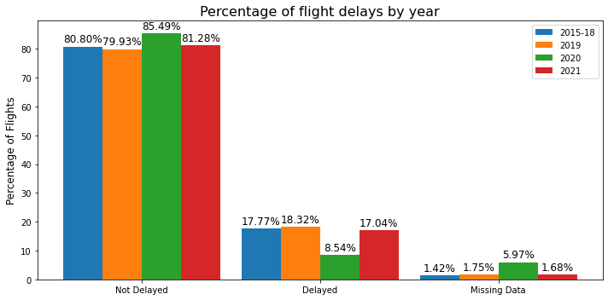
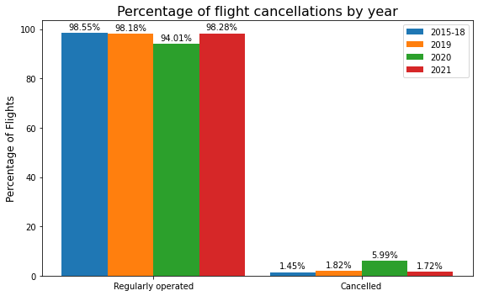
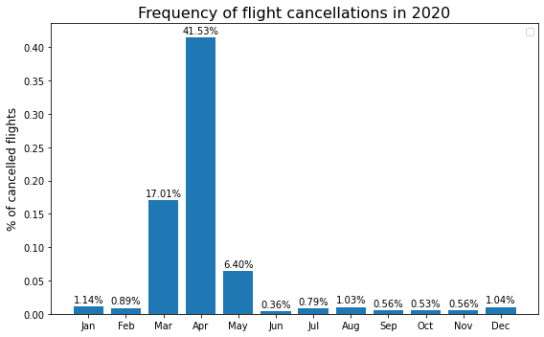
EDA: 2020 & 2021 DATA
Notes:
[DANTE]
This week, we explored the full dataset.
The delay versus non-delay imbalance was consistent across years, except for 2020 which showed less frequent delays and more cancellations, especially in the months of March, April and May.
Yet, as we are not predicting cancellations, our intuition is that our model will deliver consistent results for 2020 as long as the causes of delay have not significantly changed, which we plan to validate.

Slide 3
DATA PIPELINE
Ingest &
Join Data
Data
Cleaning
OHE & Normalizing
Write to
Parquet
Train - Test
Split
Baseline
Model
Data Cleaning
Filter out cancelled flights
Filter out information unknown 2 hrs before flight (delay performance, diversion info)
Null handling
One-hot encoded categorical data
Normalize numerical data with min-max scaler
Train/Test split
Train: 2015-2018
Test: 2019-2021
Baseline Model
Logistic Regression
Notes:
[JOY]
For our data pipeline, we ingested, joined and cleaned flight and weather data, and split into train and test sets
For our baseline model, we trained a logistic regression model using 2015 to 2018 data, and tested using 2019 data
Notes:
352,370 cancelled flights removed from train data (2015-2018), representing 1.5% of train data

Slide 4
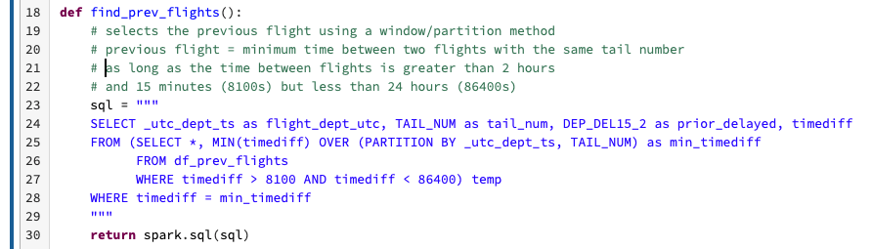
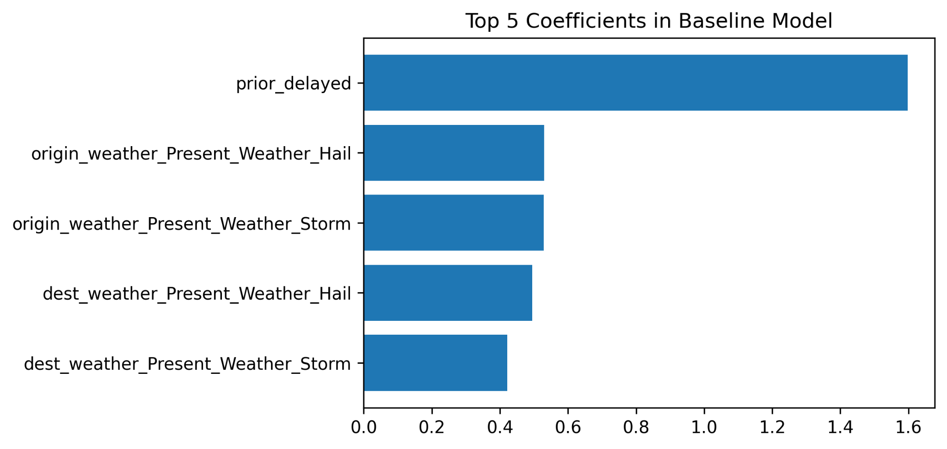
INCOMING AIRCRAFT DELAY
Notes:
[JENNY]
Intuitively, we thought that previous flight delay would be an important feature in our model.
From EDA, we found that if an aircraft is delayed there is 94% chance that the subsequent flight would be delayed. When a flight is delayed, there is a 50% chance that the incoming aircraft was late.
Our feature that flags whether the incoming aircraft is delayed ended up being the most relevant feature in our baseline model.
and Ram will talk more about our baseline model results.
We conducted some feature engineering on our dataset, including a new features that indicate holidays and each airline’s tendency to be delayed. We also added a binary feature indicating whether or not the previous flight is delayed as of 2 hours before the current flight’s departure.
Joined dataset with itself using tail number to find delay of previous flight
Previous flight must be 2-24 hours before the current flight
Note: new airlines will default as medium

Slide 5
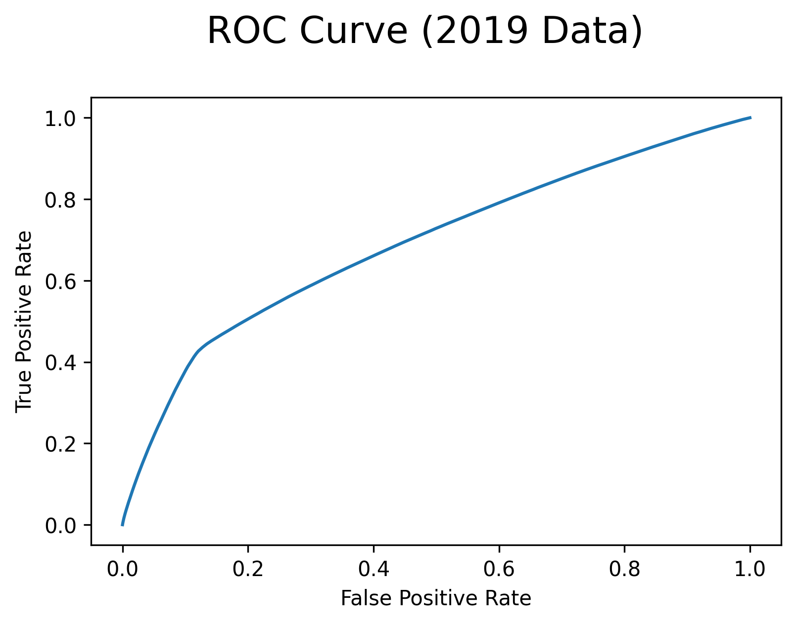
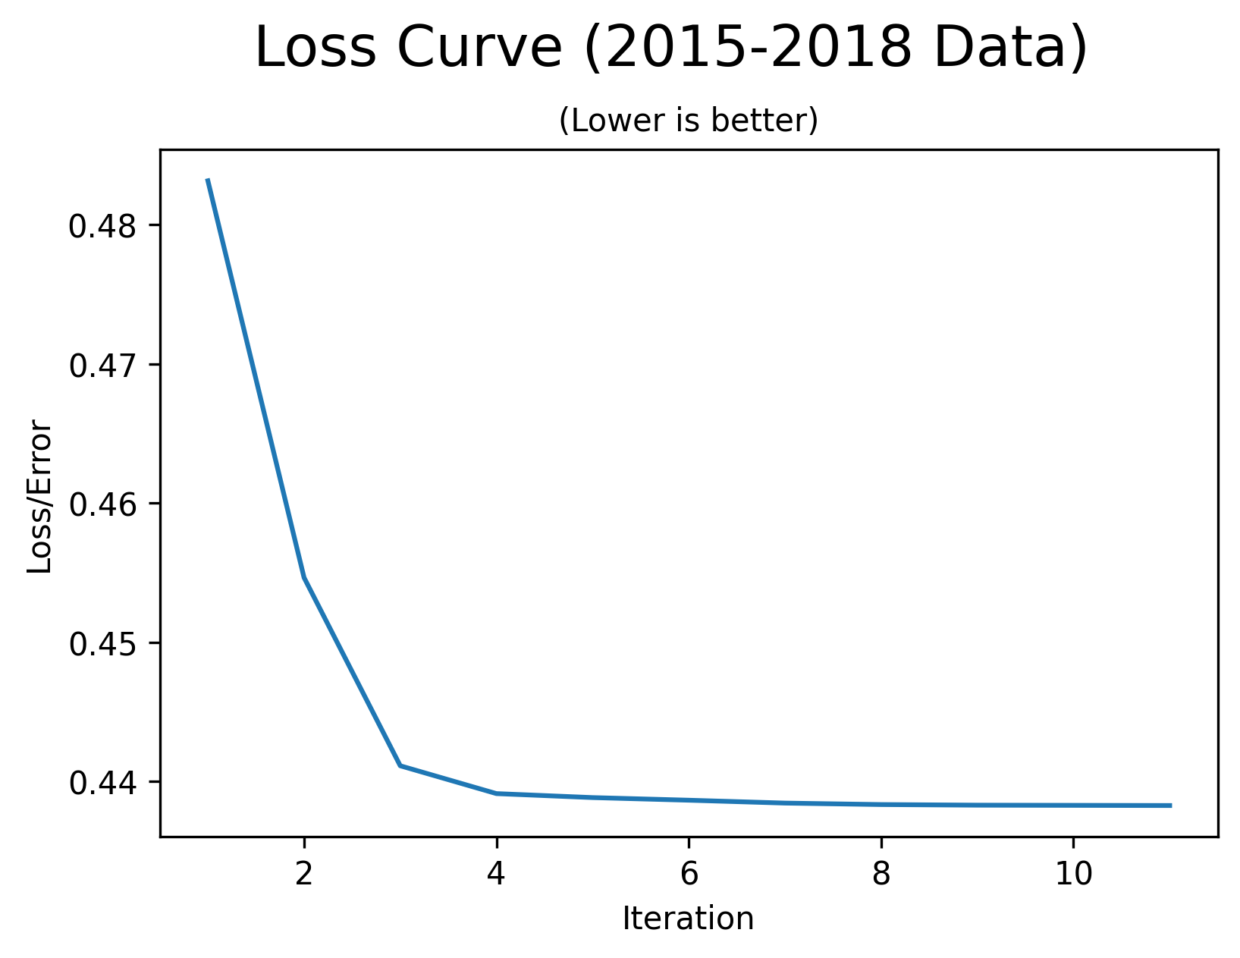
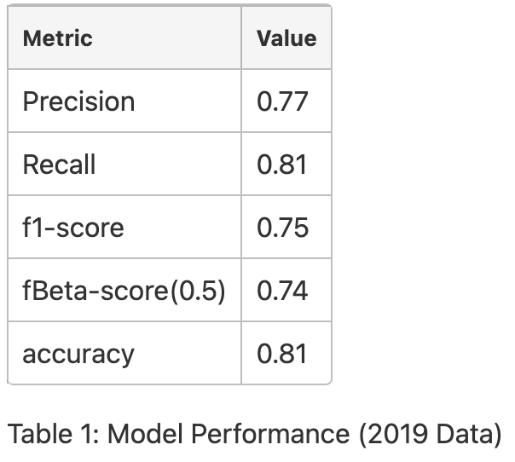
BASELINE MODEL
Logistic Regression model.
0.5 threshold.
F0.5 metric.
L1 regularization of 0.01.
Model trained on 106 features.
Cross Validation not included.
Notes:
[RAM]
We learnt a simple Logistic regression model using F0.5 as the metric. Both the ROC and the F-Beta curves show that the model hasn’t learnt all it can from the training data but it has stopped learning as Loss has plateaued.

Slide 6
OPEN ISSUES
Explore additional models
Feature engineering and selection
Hyperparameter tuning
Cross-validation strategy
Incorporating tailnum data
Notes:
[JEFF]
Thanks Ram. First we will begin exploring additional models beyond our baseline.
Next we will continue working on feature engineering and selection to improve our models performance. We will be utilizing feature importance to refine our feature set.
As well we will be utilizing grid search to tune our hyper parameters and refining our method of cross validation. Do we need to be concerned with the time aspect of cross validation?
Finally we will examine the tail number data to determine if aircraft data should be incorporated into our final dataset.
Ram:
The biggest challenge we faced was importing and ingesting 450 GB. We learned that limiting the amount of data earlier is better. Limiting to weather stations near airports reduced the ingestion time from 5 hours to 17 minutes. New data also meant we had to redo the EDA, which took time away from modeling work.
Next challenge was one of scale while join the data. We grouped both flights and weather data into 1-hour windows and filtered the weather stations, giving us a 25 minutes join time.
While doing this we inadvertently introduced data leakage which we had to fix.
[from guidelines] Performance & Scalability concerns, pipeline errors, debugging experiences
Importing about 450 GB of weather data for 7 years and manipulating it was very costly and time consuming, compounded by the inadvertent rookie mistakes. In the process, we learnt that reducing the data work much earlier in the process helps. Limiting the number of weather stations to those near airports of interest even before the ingestion process helped. We reduced the ingestion time from 5 hours to under 25 minutes.
Another challenge we had was that, by default, Spark was creating multiple 1 mb parquet files that lead to large read times. Repartitioning with year as partition key helped.
Spark's data type inference logic gave us a lot of grief. We ended up ingesting all fields as strings and applied our own conversion for the fields we need.
Grouping flights and weather into 24 windows per day (1 for the hour of the day), in addition to the reduced weather stations to look at, helped us achieve join time of about 25 minutes. The logic also includes a simple aggregation of weather data from potentially multiple readings within the hour.
Identifying potential data leakage issues with current hourly weather aggregation method
That was not easy to achieve. We had quite a few challenges. For example, we had to work with 450 GB of data, which presented challenges for importing and ingesting. We had to do a couple of iterations because of rookie mistakes.
The earlier you limit the amount of data you work with, the better.
We removed weather stations early on, which helped us implement the join in 25 minutes.

Slide 7
THANK YOU

Slide 8
OUTLINE
EDA
Data Pipeline
Business Problem
Model & Results
Conclusions & Next Steps
01
02
03
04
05
Notes:
[JOY]
Today we will discuss the business problem we are trying to solve using machine learning, the data we are using to train our model, and what we’ve learned and accomplished so far

Slide 9
2015 - 2021 DATA
Download
EDA
Clean
Join
EDA
Flights Data
From US Department of Transportation
Flights to and from US airports
40+ million flights
Weather Data
From NOAA
Focused on 40 features out of 123 total
41 million records total
Filtered to only show data from weather stations close to airports
Weather Stations
12,000 weather stations
Identified 710 stations that were close to airports
Notes:
[JOY]
For our model, we used flight data from the US Department of Transportation, which includes over 40 million flights from 2015 to 2021
We also used daily weather data collected from weather stations, published by NOAA, the National Oceanic and Atmospheric Administration
Finally, we used data on 12,000 Weather Stations data to identify 710 stations that were close to airports. We used this information to filter the weather data, which reduced the data ingestion time from 5 hours to 17 minutes
Jeff will now discuss the EDA
[OTHER NOTES]
We ended up running the full dataset join in 25 minutes.
Use 2020 & 2021 as test datasets (model will not be trained on pandemic data)
We also faced a few challenges. For example, importing and ingesting 450 GB of data was hard. We learned that limiting the amount of data earlier is better. Limiting to weather stations near airports reduced the ingestion time from 5 hours to 17 minutes. Also, Spark’s default 1 MB parquet files were not efficient. Repartitioning the data ensured better file sizes. Finally, Spark’s schema inference did not work for us. So we did explicit data type conversion.
Another challenge was the duration of the join. We grouped both flights and weather data into 1-hour windows and filtered the weather stations, giving us the 25 minutes join time.
However, by doing this, we now suspect data leakage issues which needs further investigation.
10 million new flights added to the existing 30 million (~4.6 million in 2020, ~6 million in 2021)
Our main task for this week
We downloaded new data for weather and flights
EDA & Data Cleaning
Airports in 2015-2019 but not in 2020-2021:
ART, CEC, CLD, EFD, ENV, FLO, FNL, IFP, ISN, PGV, TKI, UST, YNG
Airports in 2020-2021 but not in 2015-2019:
ALS, ALW, BIH, CDB, DDC, DEC, EAT, FOD, IPT, JST, MCW, PUW, RIW, SHR, TBN, VCT, YKM
Weather records:
2018 5930277
2015 5941610
2019 5928780
2020 5924023
2016 5961893
2017 5939039
2021 5890056

Slide 10
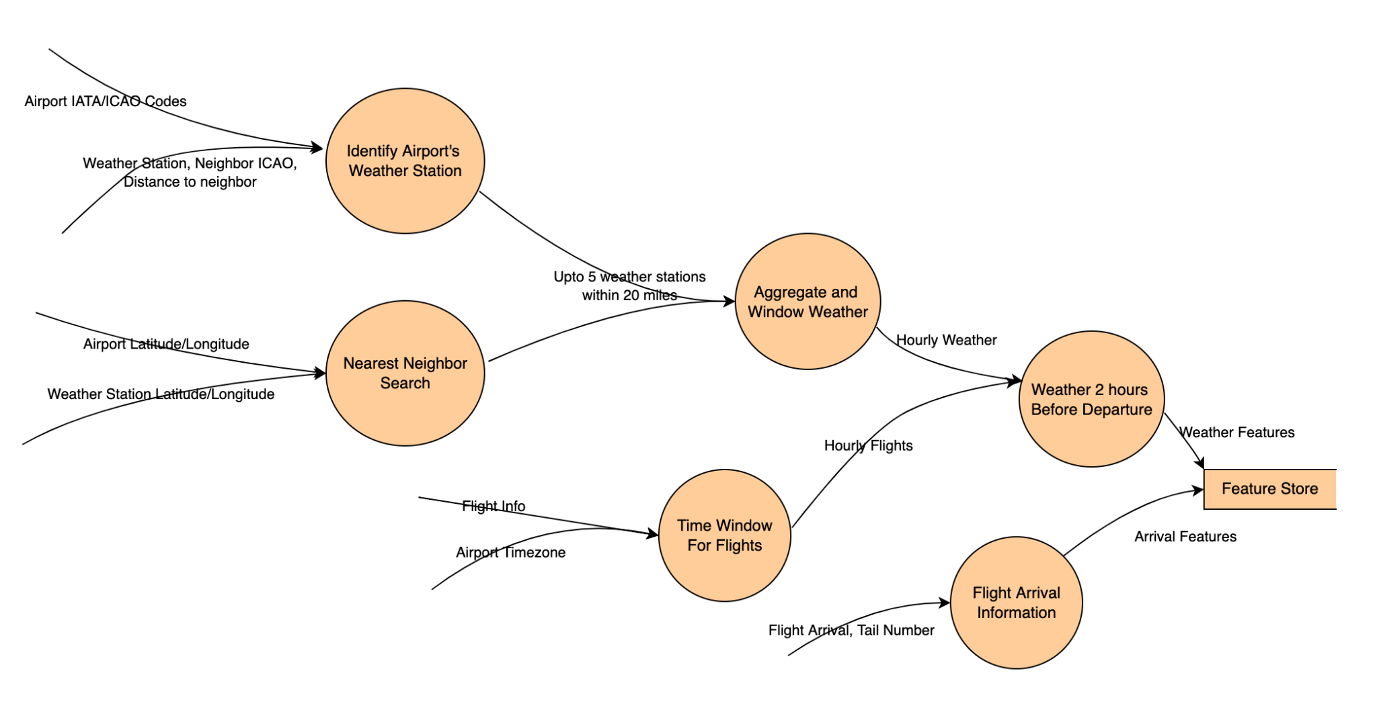
Datasets
Notes:
[RAM]
This graphic illustrates how we will be joining multiple datasets. Our combined dataset has over 30 million flights between about 370 airports in the United States and 40 million weather observations from 700 weather stations.
Key points (for any questions):
Addressing Scale
12,000 weather stations to 700 weather stations near 372 airports.
630 million observations to about 40 million observations.
31 million flights between 372 airports
Joins
IATA <-> ICAO, IANA for TZ.
Ball Tree based KNN using latitude and longitude. Upto 5 weather stations within a 20 mile radius.
Date + hour of day as partition key.

Slide 11
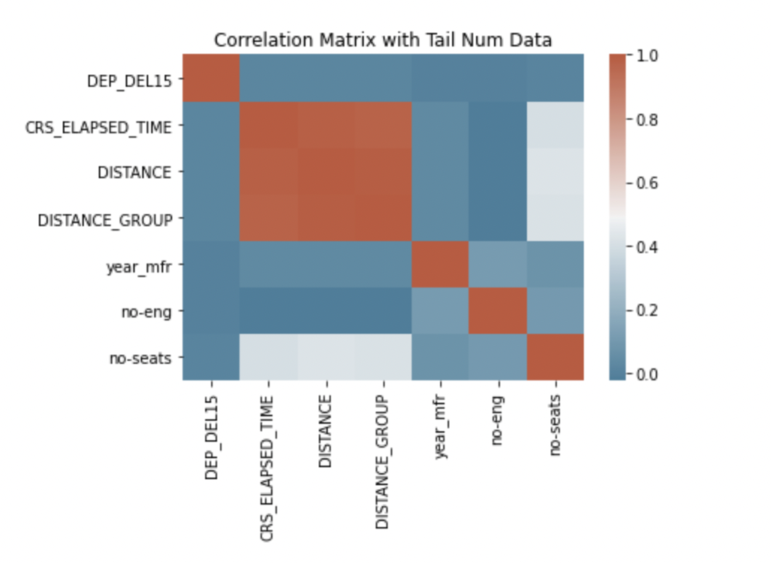
EDA: COMBINED DATASET

Slide 12
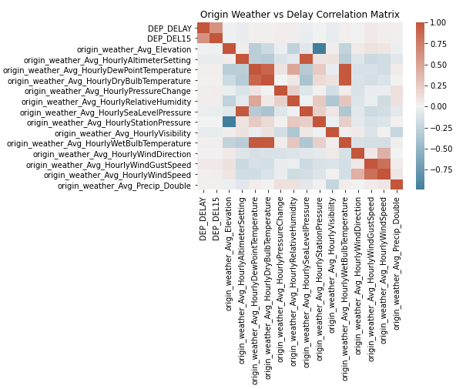
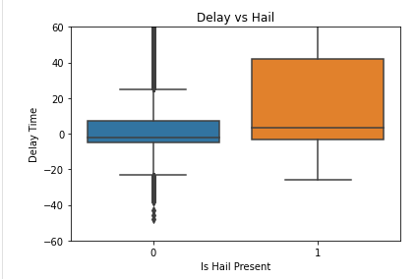
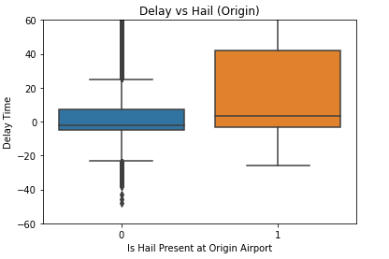
EDA: COMBINED DATASET
@DANTE
CHANGE IMAGES
Notes:
[DANTE]
Jeff:
Once the weather and flight datasets were joined we began looking at correlations between delay and weather features, as seen in this correlation matrix. We were able to identify several weather features that are highly correlated with each other. We will utilize this information when we begin looking at features importance and we start dropping features. As you can see there is no strong correlation between numeric weather variables and our label (Dep_DEL15)
We also began looking at our binary weather variables versus delay time and were able to see several trends. One of these as can be seen on the right is with “the presence of hail at the origin airport”, which is not surprising. Again we will utilize this information to help in our feature importance analysis.
Next I will hand it off to Jenny to discuss data wrangling

